Slide 1



2023-24 ASME/K-16 and IEEE/EPS Heat Sink Design Challenge
Team: Aero Pro Max
Students: Yang Zhang, Junyuan Jiang, Yiwei Wang, Luying Xia
Aerospace Engineering, Faculty of Science and Engineering
& Nottingham Ningbo China Beacons of Excellence Research and Innovation Institute
University of Nottingham Ningbo China

Slide 2
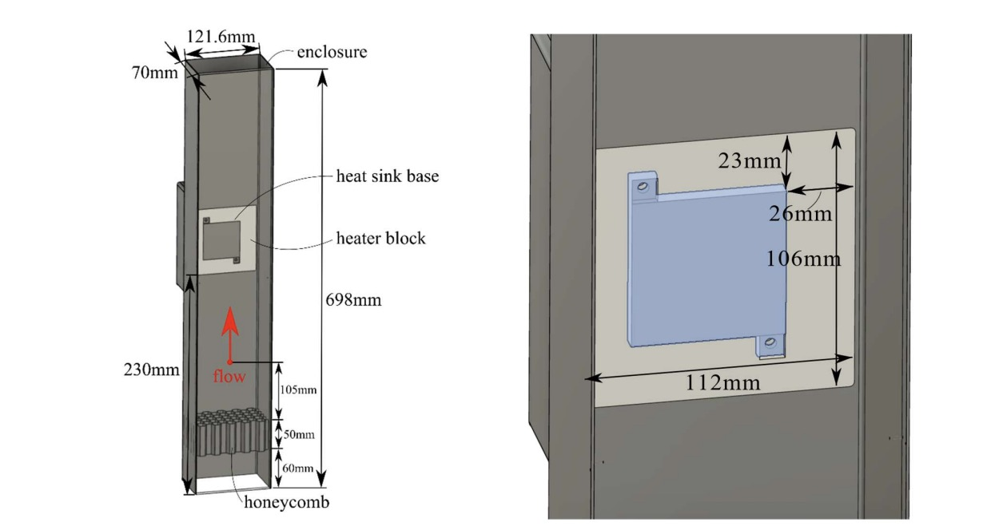
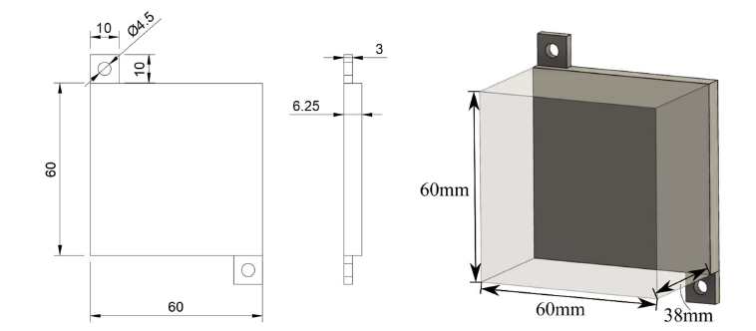
Introduction
The heat sink is a device used to conduct and dissipate heat.
Our primary motivation was to craft an innovative heat sink design that maximises the benefits of additive manufacturing, particularly in terms of intricate geometries and robust materials.
Figure 1. Design domain of the heat sink

Slide 3
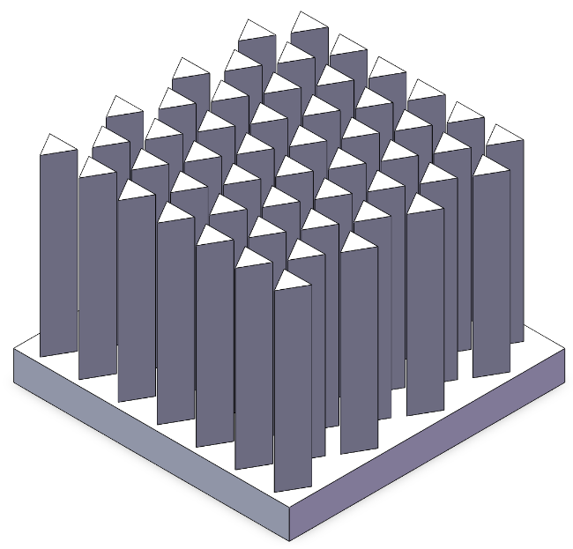
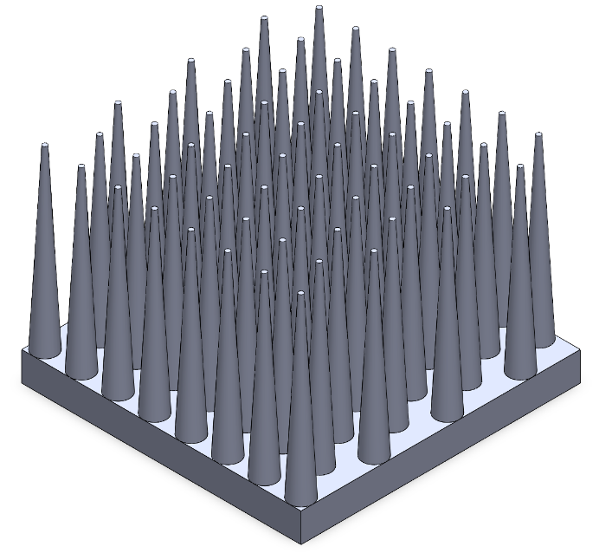
Design Concept
Pin-based heat sink
Conduction is closely associated with the cross-sectional area of the pin.
Convection is impacted by the air flow velocity and the contact area between the air and heat sink.
Good conduction
Poor convection
High wind resistance
Figure 2. Trigonal cone structure
Good conduction
Good convection
Low wind resistance
Convective heat transfer equation:
$Q=h∙A∙∆T$
Where h is convective heat transfer coefficient, which is related to the air flow velocity.
Figure 3. Circular truncated cone structure
Notes:
In today's presentation, I will explore an optimized design based on a traditional pin structure which is more efficient during conventional types such as pin, fin, and crystal.
According to the fundamental principles of heat transfer, the efficiency of a heat sink is directly influenced by conduction and convection efficiencies. Among these, the conduction efficiency is closely associated with the cross-sectional area of the heat sink, while the convection efficiency is impacted by the air flow velocity and the contact area between the air and the heat sink according to the equation.
To create a heat sink with superior performance, it is imperative to strike a balance between thermal conduction and convection. In our pursuit, we considered various unconventional designs, such as implementing a trigonal cone structure to increase the contact area. However, although this design expands the contact area, it also significantly raises wind resistance and diminishes the average air flow velocity.
To address this challenge, we introduced a circular truncated cone as a pin of the heat sink. Combining it with the principles of heat transfer, we recognized that the temperature difference would gradually decrease with the height of the pin. Consequently, we devised a circular truncated cone with a progressively decreasing diameter from bottom to top, enabling more efficient space utilization while maintaining high heat transfer efficiency.

Slide 4
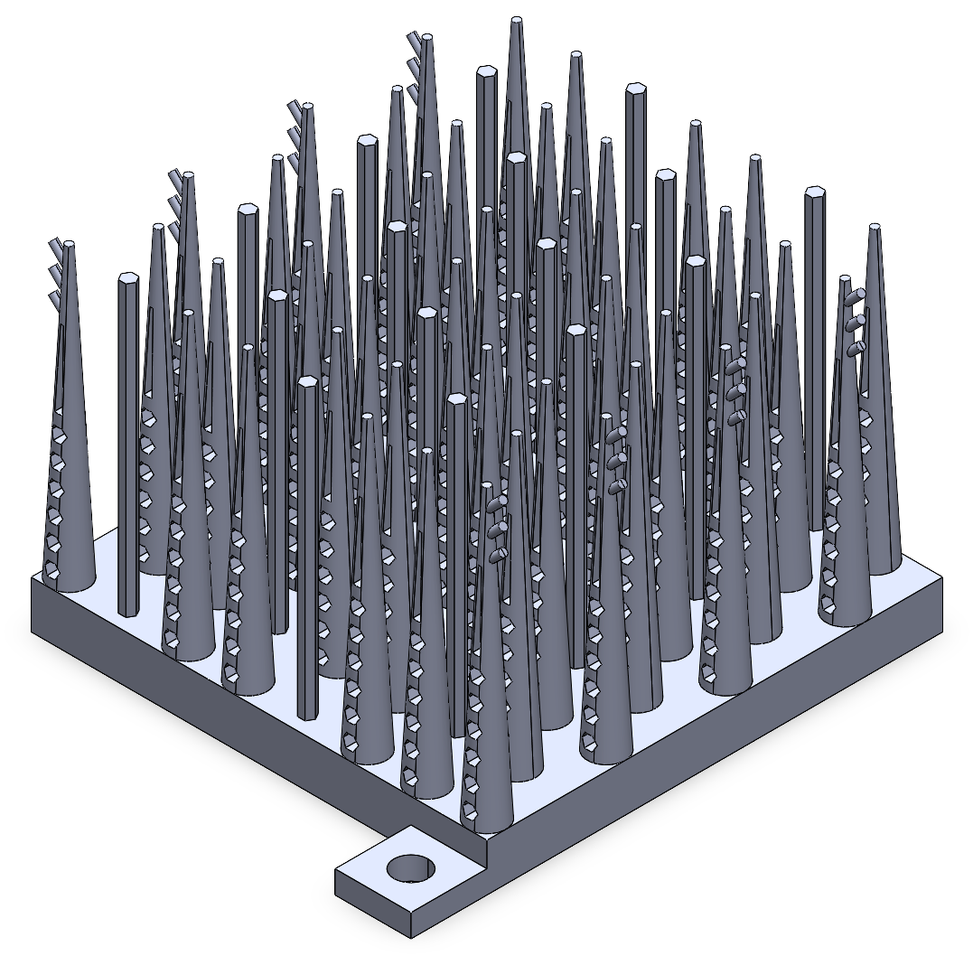
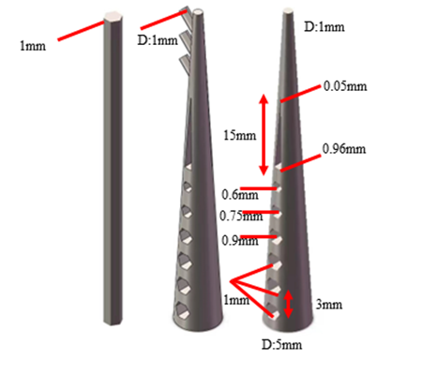
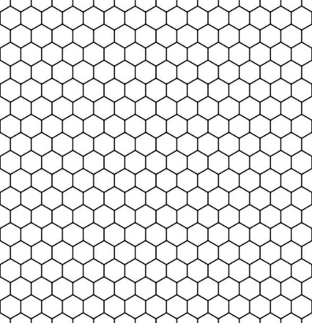

Structural Design
Innovative distribution
Light weight design
Honeycomb distribution
Bionic design
Hexagonal & Porous cone pin structure
Figure 4. Primary design
Enhanced turbulent intensity
Honeycomb and dendritic structure
Notes:
Regarding the arrangement of the pin structure, we drew inspiration from the bionic design of honeycombs found in nature. Employing the concept of fractal design, we skillfully integrated several hexagonal features into the heat sink design, including hexagonal holes and arrangement. This design enhances the turbulent intensity of the heat sink, increasing the contact area between the air and the heat sink to improve convection efficiency. Furthermore, we observed that the uniform distribution of pins hinders the flow at the back of the heat sink. To address this issue, we strategically staggered the pins and replaced some of them with regular hexagonal pins to enhance the air flow velocity.
Additionally, we observed that the air flow velocity is higher on both sides of the heat sink. To capitalize on this phenomenon, we incorporated dendritic structures on both sides of the heat sink, resembling branches found in nature. These dendritic structures guide the air and enhance overall heat dissipation.
Through this series of optimized designs, we successfully developed a heat sink with exceptional performance and a rational structure.
Junyuan Jiang will introduce the simulation part.

Slide 5
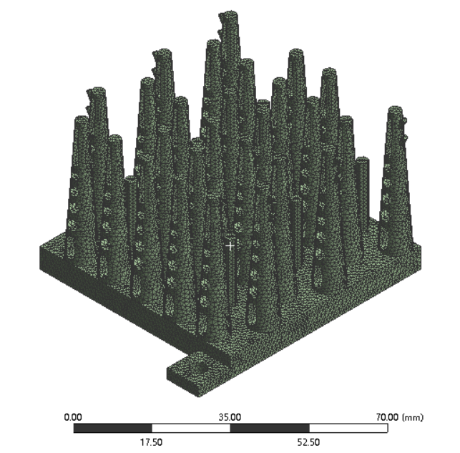
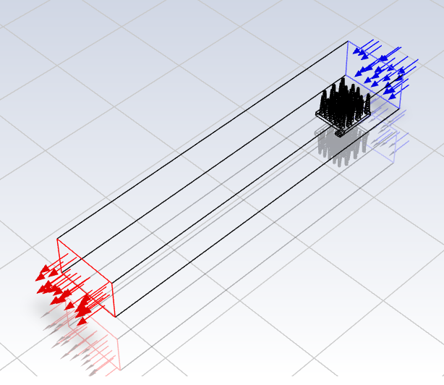
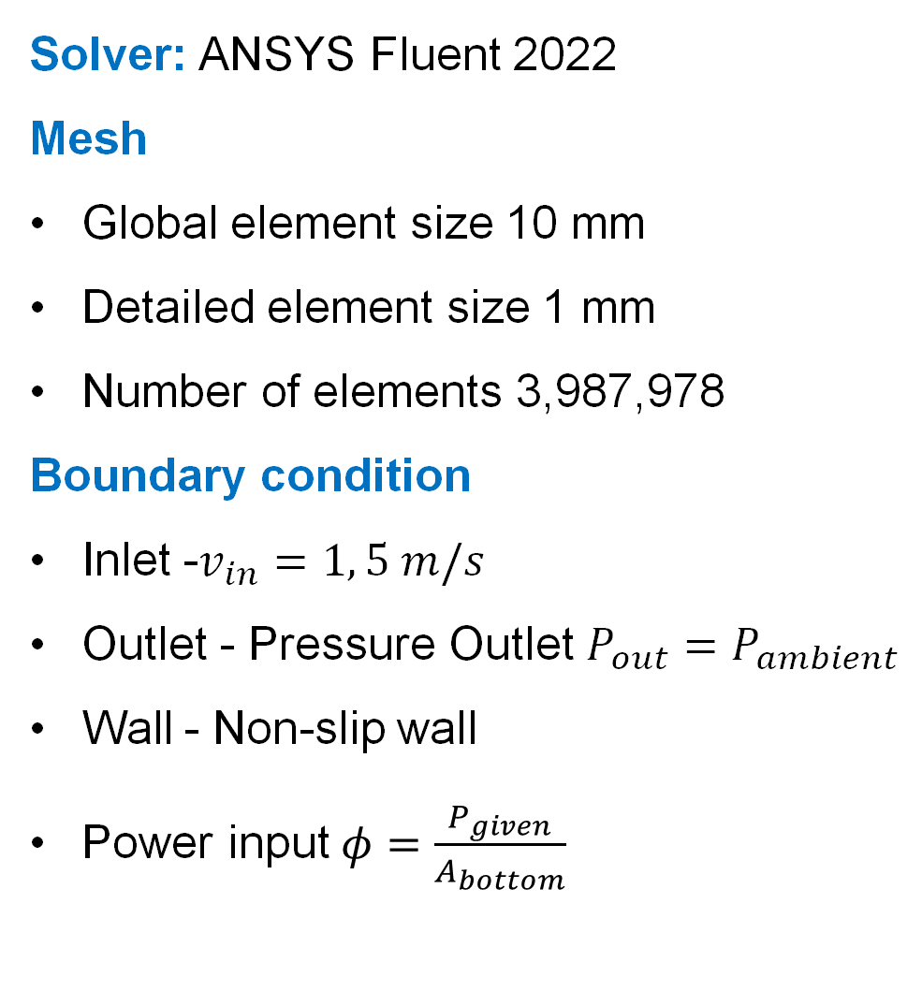
Numerical Simulation Set-up
Solver: ANSYS Fluent 2022
Mesh
Global element size 10 mm
Detailed element size 1 mm
Number of elements 3,987,978
Boundary condition
Inlet -$v_{in}=1, 5 m/s$
Outlet - Pressure Outlet $P_{out}=P_{ambient}$
Wall - Non-slip wall
Power input$φ=\frac{P_{given}}{A_{bottom}}$
Inlet
Wall
Outlet
Figure 5. Simulation set-up
Notes:
Next, I will introduce the Set-up of the Fluent simulation. The size of the mesh of the fluid domain is 10mm and it of the heat sink is 1 mm. The inlet velocity is 1meter per second and 5 meter per second. The boundary condition of the outlet is ambient pressure outlet. The material used for heat sink is 316L steel.

Slide 6
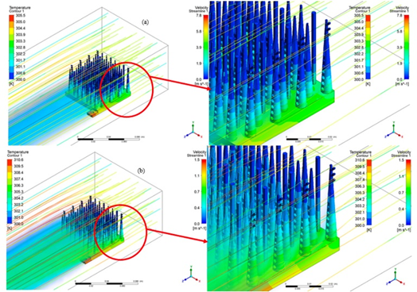
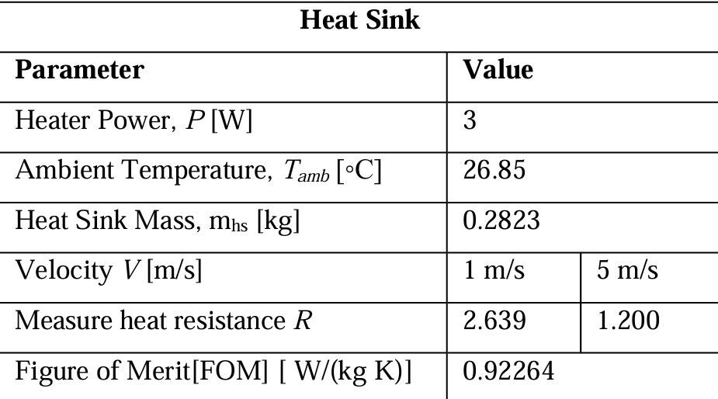
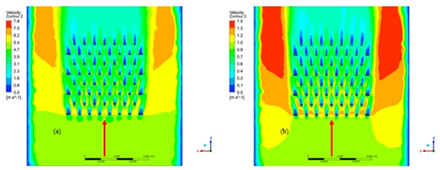
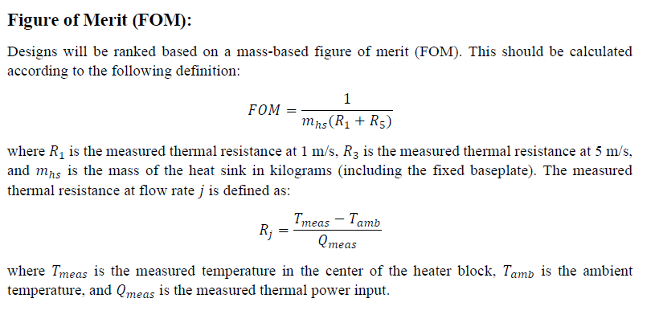
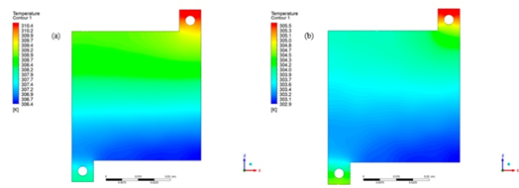
Simulation results
TABLE 1. Predicted FOM of the design heat sink
Contour of temperature distribution on the surface of the heat sink
Flow velocity contour on the plane parallel to the plane with a height of 31 mm
Temperature contour of the bottom surface of the heat sink
Figure 6. Simulation results
Notes:
From the simulated results, the contour of temperature, flow velocity and pressure distribution can be predicted. Therefore, the Figure of merit FOM can be calculated. Next, welcome Yiwei to introduce the manufacturing part.

Slide 7
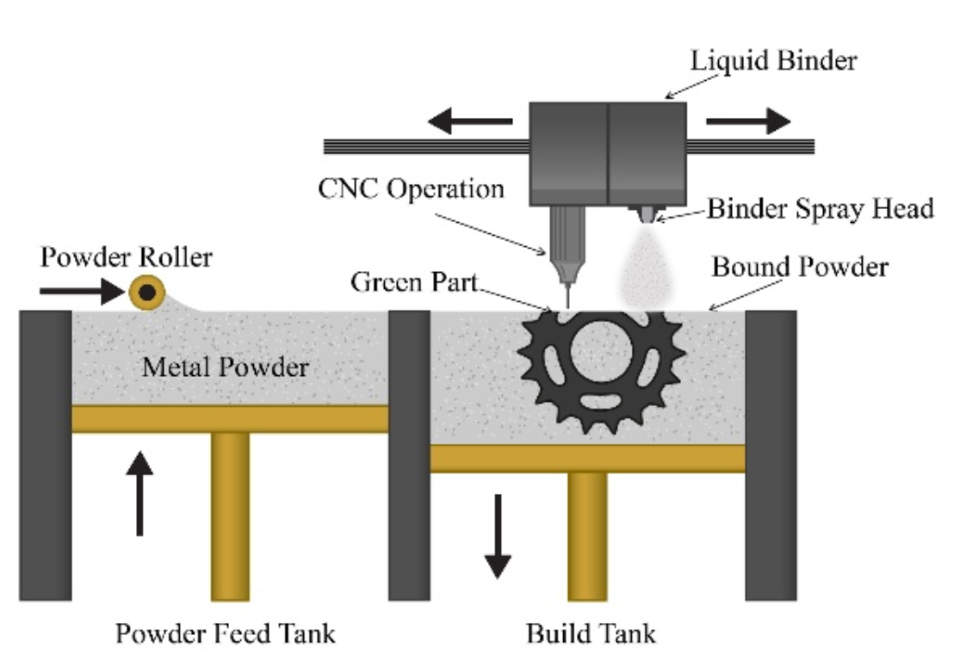
Additive Manufacturing Technique
Holes of different shapes
Dendritic structure
Dense arrangement of hexagonal prisms and conical pins
Figure 8. Binder jetting metal additive manufacturing
Figure 7. Structure analysis for manufacturing
Notes:
As shown in the graph, several design features such as dense arrangement of hexagonal prisms and conical pins, holes of different shapes and dendritic structure were adopted in our heat sink structure. These design features made the structure virtually impossible to be manufactured through conventional manufacturing methods. The additive manufacturing technique that we used is Binder jetting metal, which have the advantages of high speed, superior print quality and high resolution.

Slide 8
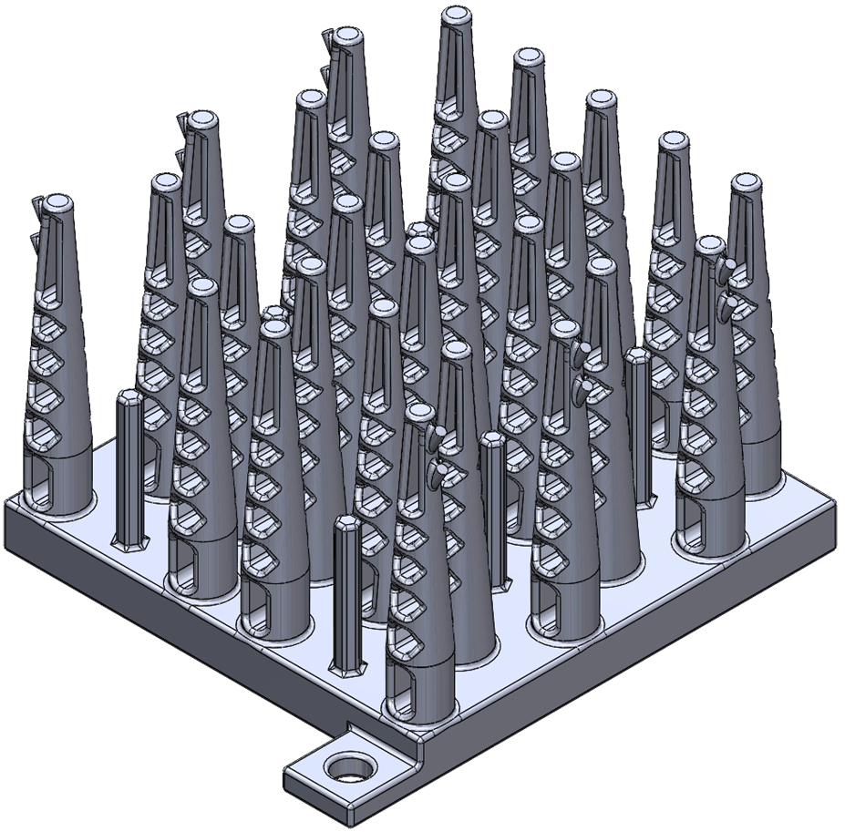
Design for Additive Manufacturing
Aspect ratio smaller
than 6.7
Angle larger than 60 degrees to horizontal direction
Rebuild the model to ensure all the feature sizes are greater than 1.0 mm.
Change to ellipse
chamfer
Figure 9. Modification of the design for binder jetting
Notes:
However, the design of heat sink was limited by several manufacturing constraints. Several changes were made to ensure the successful printing of the heat sink. Firstly, the top and basal diameter of the conical pins and hexagonal prisms were increased, and the height of the hexagonal prisms were reduced to ensure that the aspect ratio was smaller than 6.7. The modified equivalent diameter of the conical pins and hexagonal prisms were 5.555mm and 2.728mm respectively. After modification, the aspect ratio of both is 6.69. Secondly, the model was rebuilt to ensure all the features size are greater than 1mm. Thirdly, the overhand angle of the dendritic structure was changed to larger than 60 degrees to horizontal direction. Fourthly, the corners at acute angles were chamfered to greater than 0.5mm. The last change is to replace the original hexagonal holes at the bottom of the conical pins with an ellipse to make it easier to clean and to increase the heat transfer efficiency.

Slide 9
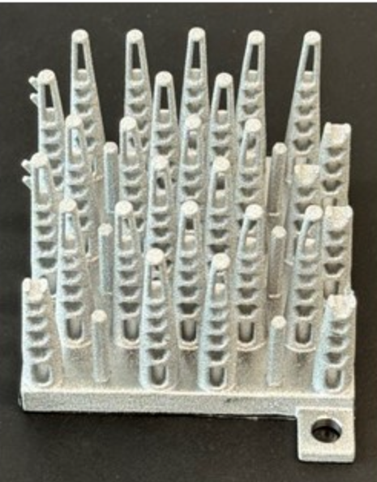
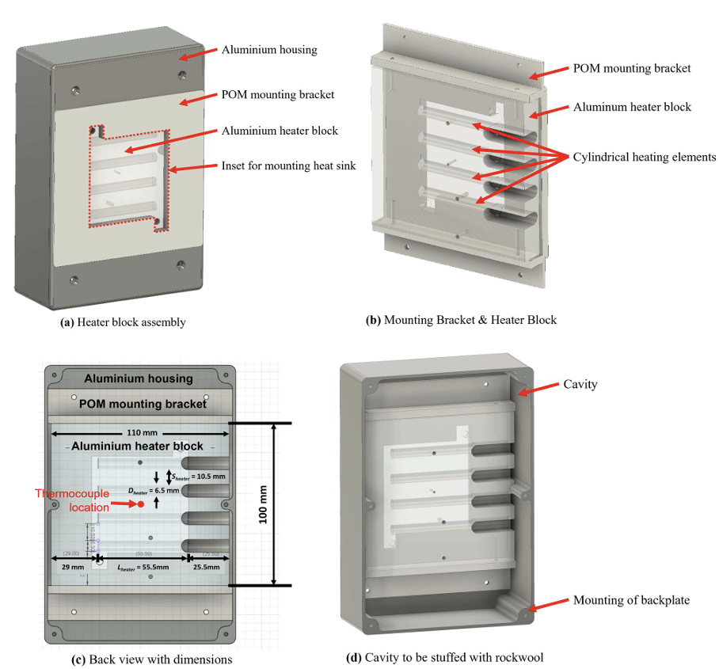
Experimental validation
Figure 10. Printed heat sink and experimental set-up
 |  | Delta T [K] |  | R [K/W]
 | Weight [g] | 1 m/s | 5 m/s | 1 m/s | 5 m/s | FOM
Experiment | 314.20 | 28.80 | 17.90 | 1.60 | 0.99 | 1.19
Simulation | 316.50 | 41.23 | 20.79 | 2.29 | 1.162.29 | 0.92
Error: 22.7%
Notes:
Hi, nice to see you again. Now The performance of the printed part is measured and recorded in the table. The temperature at the center of the bottom surface of the heat sink is measured under the conditions of 5m/s and 1m/s. The FOM obtained by the experiment is 1.19, which is much better than the simulated result. While the simulated result is 0.92. The error is 22.7%. I will explain the large error now.

Slide 10
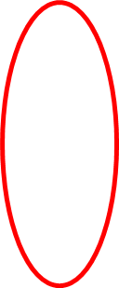

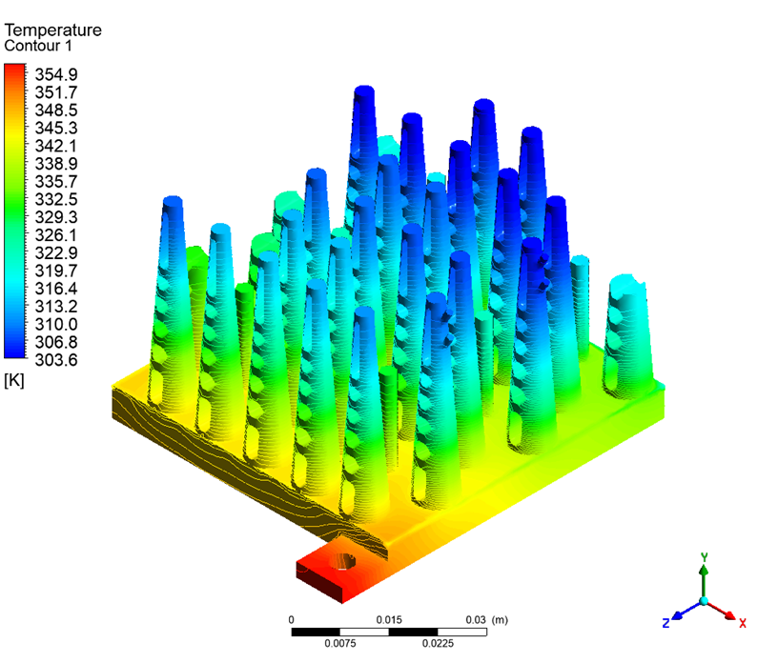
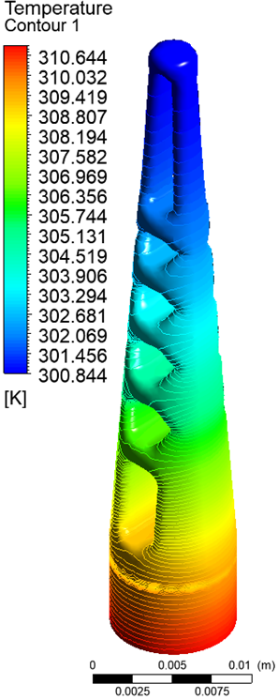
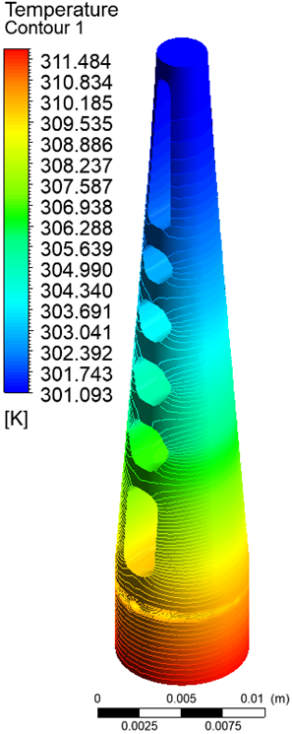
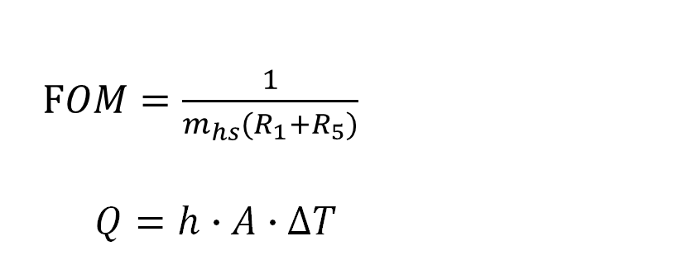
Error analysis
1. The breakage of the pins impact on FOM 1.1% error
2. Chamfer of pins impact on FOM 9.2% error
3. Surface roughness of the printed model h coefficient
4. Heat transfer: Incomplete to heat sink.
$FOM=\frac{1}{m_{hs}(R_{1}+R_{5})}$
$Q=h∙A∙∆T$
With Chamfer
Without Chamfer
Figure 12. Simulation results of the pin with and without chamfer
Figure 11. Simulation results of the breakage heat sink
Notes:
The first source of error is that the 3D printed heat sink model was damaged. After simulating the damaged heat sink, it was found that the damage only caused 0.01 decrease in FOM. Which account for 1.1% percentage of error.
The second reason is that many simplifications were made to the model of the heat sink during simulation. For example, the chamfer of the heat sink was not considered. Additionally the surface of the 3D printed heat sink is rougher than the metal surface manufactured by traditional CNC, increasing the value of h. Thus, the higher FOM.
The fourth reason is that in the real experiment the heat loss exist. Not all the heat generated by heat source transfer to the heat sink. This also lead to a huge difference when calculating the R1 and R5.

Slide 11
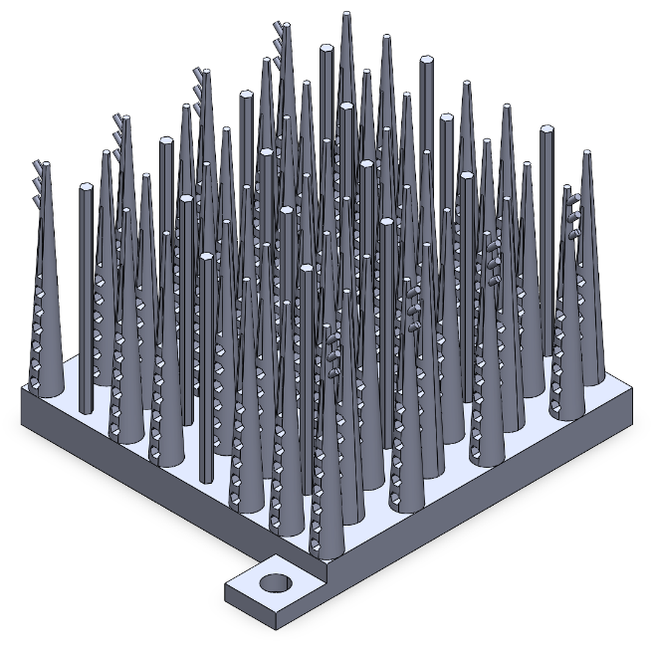
Conclusions
Figure 13. Design, analysis, and additive manufacturing procedure of the novel heat sink
A bionic heat sink: conical pins, honeycomb holes, raised branches, a honeycomb pattern, and enhanced aesthetic appeal.
The predicted figure of merit (FOM) was calculated to be 0.92264 W /(kg·K).
The aspect-ratio, 60-degree rule and minimal feature size were strictly followed to make the designed heat sink suitable for fabrication by binder jet additive manufacturing.
The Experimental FOM was measured to be 1.19 W /(kg·K), together with convincing error analysis.
Notes:
As team AERO Pro Max, we embarked on the creation of a bionic heat sink featuring conical pins adorned with honeycomb perforations and raised branches arranged in a honeycomb pattern, aimed at enhancing the aesthetic appeal of the heat sink. Through meticulous simulation using ANSYS Fluent, we analyzed the airflow velocity and temperature distribution of our design. The resulting average temperatures under 1 and 5 m/s airflow conditions were determined to be 307.917 K and 303.601 K, respectively, with a mass of 0.2823 Kg. Notably, our final (FOM) was calculated to be 0.92264 To ensure suitability for binder jet additive manufacturing, we strictly adhered to aspect-ratio guidelines, the 60-degree rule, and minimal feature size requirements，to make the designed heat sink suitable for fabrication by binder jet additive manufacturing. Comparing the experimental data with the theoretical data, the experimental data obtained a better FOM value of 1.19, which is a good result. Finally, the innovative , more efficient heat sink can be 3d printed

Slide 12

Acknowledgements
The team is grateful for the kind and professional guidance from Dr. Yi Nie and Dr. Shanshan Long from the University of Nottingham Ningbo China.
The project is also supported by UNNC Boeing Aviation Club Fund.
Notes:
2023-24 ASME/K-16 and IEEE/EPS Heat Sink Design Challenge
In the end, We would like to thank the supervisor, sponsors and organizers.

